Slide 1


Theme: Fashion

Slide 2
TEAM DARK KNIGHTS
HELLO!
Leader: Deepak Chaurasia
Member: Kishan Baranwal
College: Ajay Kumar Garg Engineering College

Slide 3
A WALKTHROUGH
Introduction
Storyboard/Wireframes
Assets built used
Relevance to theme partners
Screenshots
Unique Features

Slide 4
SCREENSHOTS

Slide 5

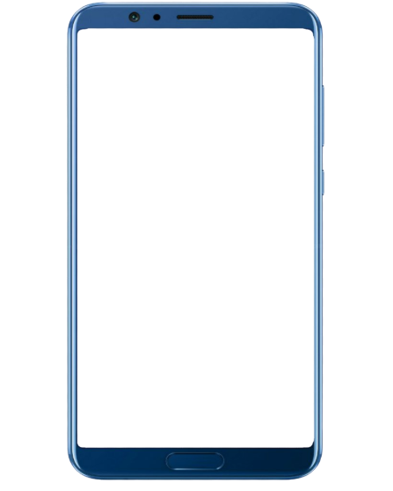
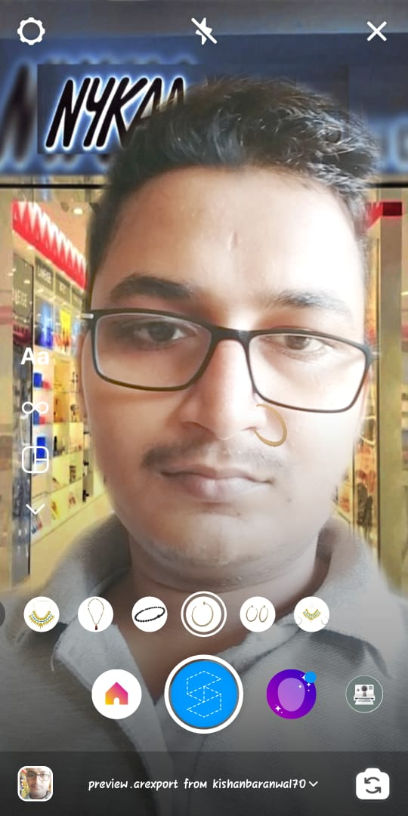
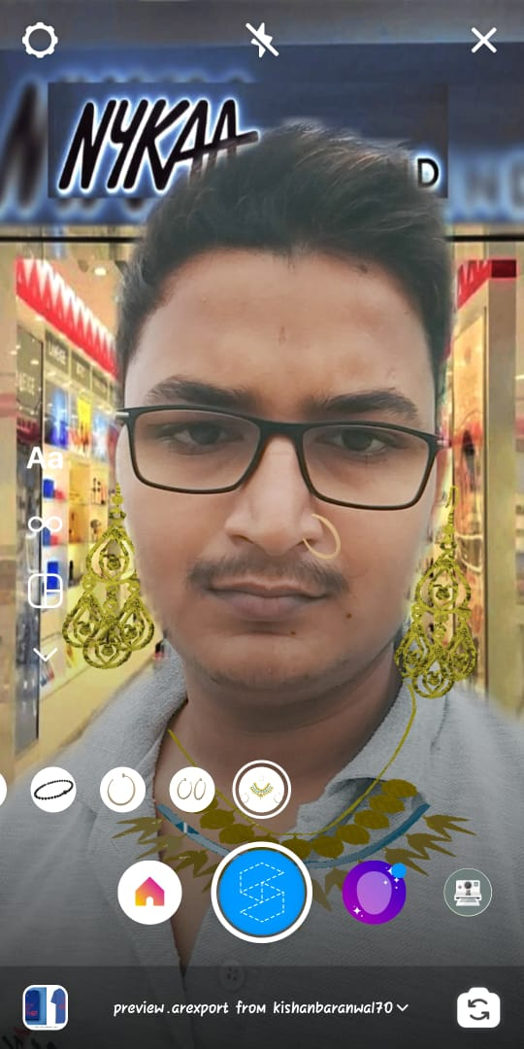

Slide 6
Unique Features
Used Nykaa showroom pic as background segmentation, to make the user feel the real experience of trying on jewellery as they are in the showroom.
We have added tap to hide feature for 5 sec in sets asset so that user can experience there look on any particular jewellery among sets.
For ex: As in set of necklace and earring someone like necklace,someone earring,someone nose-ring,and so on.

Slide 7
Thank YOU!
Thank You for choosing us to be the part of this course by SV and Facebook!!

